Slide 1
Good Afternoon
Thanks for joining us, we’ll begin shortly (2:02ish)…
This session is being recorded
Today’s topic is AB705
A supplementary (optional!) document of the data tables for today’s presentation is available at: https://bit.ly/2GpELH7
Includes information by college and all disaggregations covered today

Slide 2
AB705 in 2020: First Full Year of Implementation
Office of Accreditation, Institutional Research, Effectiveness, and Planning

Slide 3
Session Learning Outcomes – AB 705
Based on this session, participants will understand...
the impact of placement changes on math and English enrollment
changes to course success rates resulting from AB 705
the concept of throughput and how this is applied to math and English under AB 705
equity implications of AB 705 and disproportionate impacts in math and English

Slide 4
Definitions and Acronyms – Math Pathways
SLAM/TP Math - Stats, Liberal Arts Math/Teacher Prep
Math pathway courses including:
MATH-025 Stats
MATH-045 Quantitative Reasoning
MATH-010A Structure & Concepts
These courses use one set of placement criteria
STEM Math – Math for students in a STEM Pathway
STEM Pathway courses:
MATH-015 Pre-Calc
MATH-016 Pre-Calc and Trig (began fall 2020)
MATH-001A Intro to Calculus

Slide 5
AB 705 Timeline
AB 705 signed into law in October 2017, focusing on:
Direct Placement into transfer-level math and English
Math and English completion within one year
Innovative approaches to academic support
Placement by high school GPA and coursework
First full implementation term was Fall 2019
Math and English courses with corequisite support offered at both Colleges
First full year of data is finalized (through summer 2020)
Most enrollment/data tracked here begins with fall 2019 cohorts
COVID-19 introduced a massive disruption; interpretation of the One-Year Throughput Rates as specified in the original AB705 Implementation Memo should keep this in mind
Notes:
Spring disruption:
Since we are trackign Fall starts (because of one year through-put, and because the idea is that most students will complete in one term, impact so far seems relatively limited)
probably some loss in outcomes/throughput for students moving on in sequence (math – algebra and beyond), and potential disruption to repeats for students unsuccessfull in initial fall term
PROBABLY DON"T NEED TO GET INTO THIS....
Throughput for spring 2020 starting students (how many?) will be available at end of fall term
Spring first attempts:
English 352 (-30 from previous)
Math 469 (-30 previous spring)
- given lower enrollment in 2019-20, probably not much of a change proportionally

Slide 6
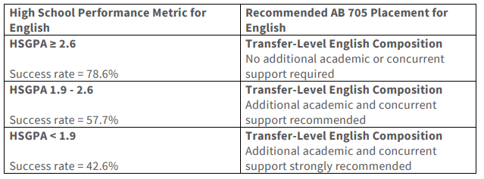
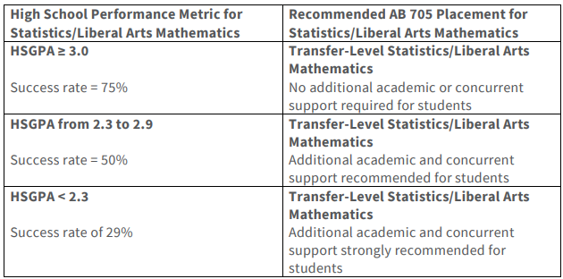
High School GPA - Default Placement Guidelines from CCCCO
WHCCD opted to require support courses for lower GPA bands
Success rates are based on the MMAP team’s baseline success rates of students in the band were placed directly into transfer level courses. – Source: AB 705 Implementation Memo

Slide 7
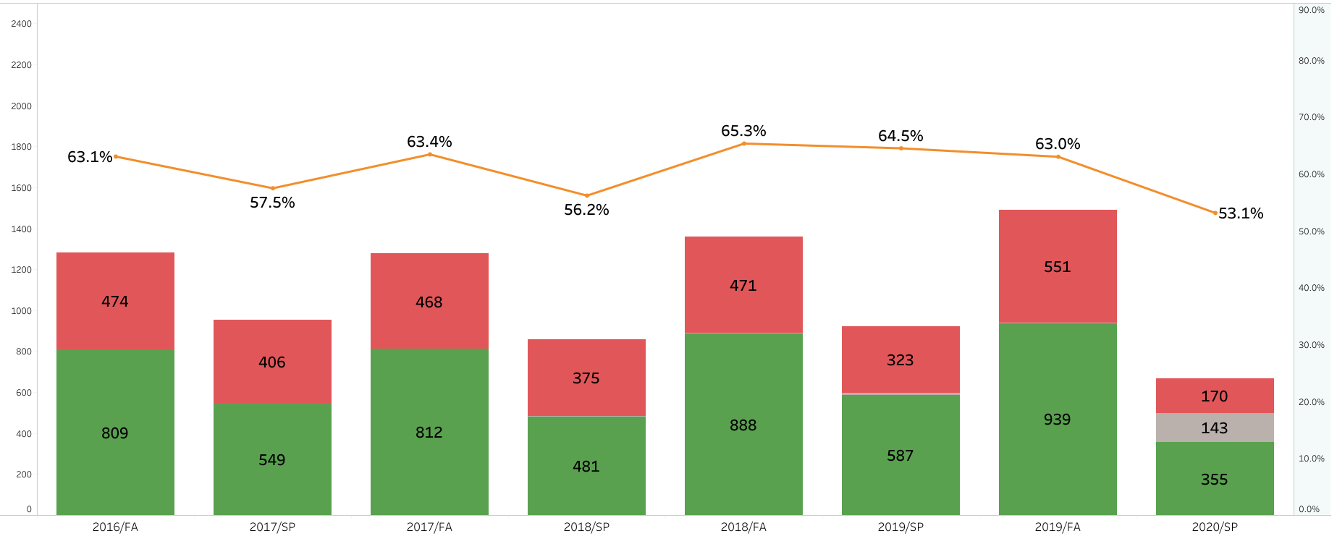
District Course Success Rates and Enrollment – English
Notes:
Keep in mind – first time and continuing students
Analysis: This view of alternating fall and spring course success in the subject shows when student generally take these classes, Fall, the increase in enrollments, and how success has changed overtime.
This is English and fall ’16, the first bar, is the first semester of corequisite remediation. On course success, not a lot changed initially with fall generally higher and spring generally lower. 2019 ‘SP was the exception but with the interruption of the coronavirus pandemic in spring 2020, the success rate dropped back to about the same level as ‘17 and ‘18 spring.
Thru fall:
RATES STABLE, but HEADCOUNT (slightly) INCREASING
Lower spring 2020 English enrollment – more getting frontloaded to fall '19? - and 10% drop – impact of disruption – didn't see this drop across the board, but shows up here in English..and next slide in math

Slide 8
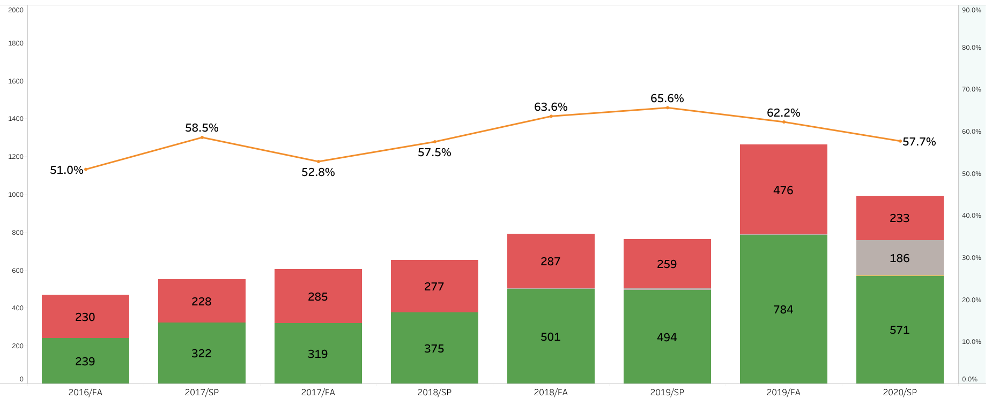
District Course Success Rates and Enrollment – Math
Statistics, Liberal Arts, Teacher Prep Math Courses: Math-010A, -025, -045
About the same # passing in fall 2019 vs attempting in prior fall/spring
Notes:
Keep in mind – first time and continuing students
Analysis: This view of alternating fall and spring course success in the subject shows when student generally take these classes, the increase in enrollments, and how success has changed overtime. Unlike English, the number of enrollments doesn’t alternate with fall high, spring low. Instead, enrollments gradually increase, with spring ‘19 the first term with a slight dip, and then goes from around 755 to 1260, a 66% increase. With this higher fall enrollment, last spring the count started to mirror the pattern we see for English. Likely driven by pathways and greater emphasis on students making an attempt in math as soon as possible (early momentum and scff)
This is non-STEM math and fall ’19 is the first semester of corequisite remediation. On course success, there were some bumps but things have trended upward as accesses to these transfer level courses was broadened by early multiple measures for placement. With interruption of the coronavirus pandemic in spring 2020, the success rate dropped back to about the same level as ‘17 and ‘18 spring.
Spring 2020 success rate is down – impact of instructional disruption

Slide 9
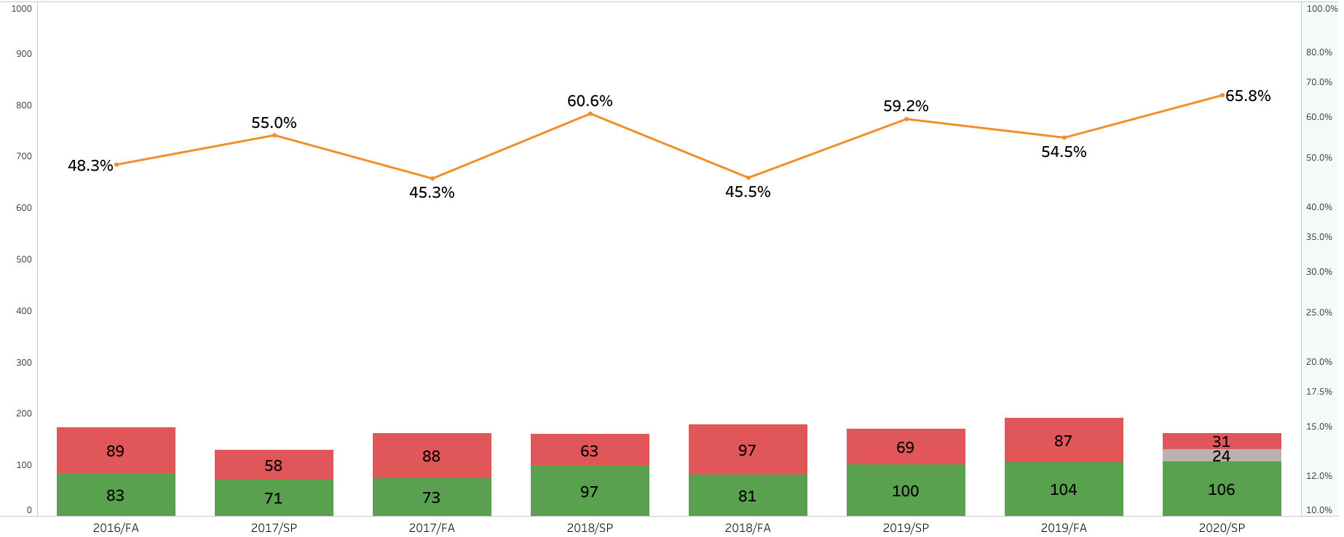
District Course Success Rates and Enrollment – Math
STEM Math Courses: Math-001A & -015
Notes:
SPLIT INTO SEPARATE SLIDES FOR 1a/15 and 64/65
Analysis: This view of alternating fall and spring course success in the subject shows the stable number of enrollments, and how success has changed overtime. Back to seeing some alternating of number of enrollments with fall high, spring low but not as extreme as English. Enrollments gradually increase, with spring ‘19 the first term with a pretty large increase from the prior fall, and then and another increase in fall 2019. With this higher fall enrollment, last spring the count started to mirror the pattern we see for English and non-STEM math.
Fall ’19 is the first semester of corequisite remediation. On course success, there were some bumps but things have leveled off as access to these courses was broadened by early multiple measures for placement. With interruption of the coronavirus pandemic in spring 2020, the success rate ended up being the second highest of all these semesters – and that’s including EW’s in the denominator.

Slide 10
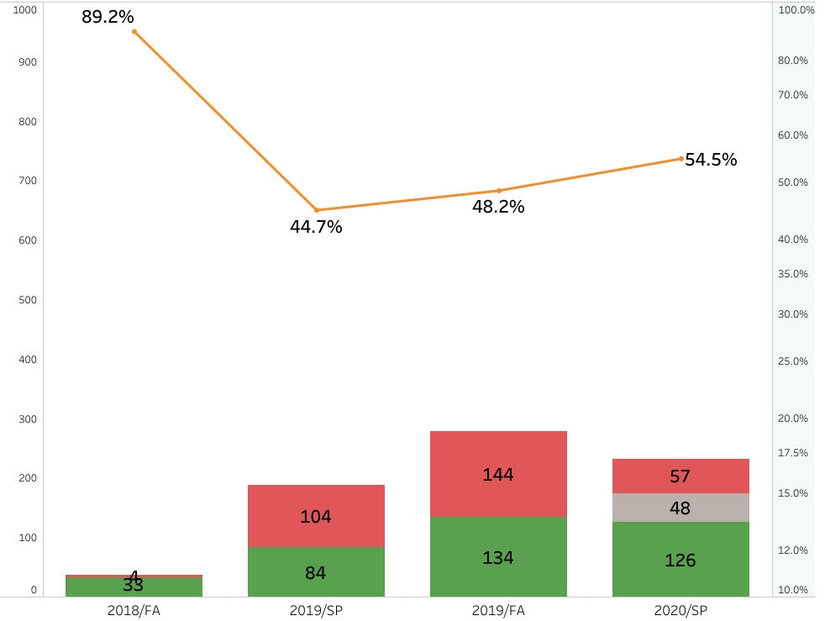
District Course Success Rates and Enrollment – Math
Pre-Transfer Algebra Math Courses: Math-064 & -065
Notes:
Multiple purposes – STEM pathways, plus other programs requiring algebra ii (nursing, etc.), plus studetns wanting to grad w/o transfer math
Analysis: This view of alternating fall and spring course success in the subject shows when student generally take these classes and how success has changed overtime. Back to seeing some alternating of number of enrollments with fall high, spring low but not as extreme as English. Enrollments gradually increase, with spring ‘19 the first term with a pretty large increase from the prior fall, and then and another increase in fall 2019. With this higher fall enrollment, last spring the count started to mirror the pattern we see for English and non-STEM math. Likely driven by pathways and greater emphasis on students making an attempt in math as soon as possible (early momentum and scff)
This STEM math and fall ’19 is the first semester of corequisite remediation. On course success, there were some bumps but things have leveled off as access to these courses was broadened by early multiple measures for placement. With interruption of the coronavirus pandemic in spring 2020, the success rate ended up being the second highest of all these semesters – and that’s including EW’s in the denominator.

Slide 11
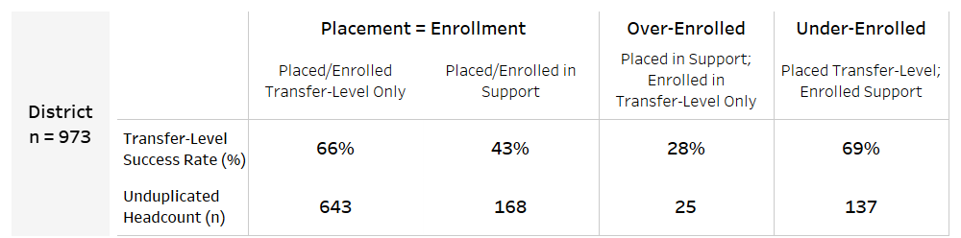
District - Alignment of Placement, Enrollment, Success
First-Time Enrollments for Students in Fall 2019
ENG-001A
SLAM/TP:
MATH-010A,
-025, -045
STEM:
MATH-001A,
-15,
Special Admit and Incarcerated Students are not included.
Notes:
So are students under or enrolled for how they were assessed. Yes, this happens and it’s okay for it to happen if that is what is best for the student and maximizes the likelihood of their success…. So, does it maximize the likelihood of their success? What if the likelihood of success is about equal?

Slide 12
Throughput – What is it and why do we care?
It is the law...AB 705 requirements
“The bill requires that a community college district or college maximize the probability that a student will enter and complete transfer-level coursework in English and math within a one year timeframe and use, in the placement of students into English and math courses, one or more of the following: high school coursework, high school grades, and high school grade point average.” - What is AB 705 CCCCO website
1 semester vs 3 term sequence + attrition
Throughput vs course success
But success was great in English 100....
See the AB 705 Implementation Memo Here

Slide 13
Best Case Scenario of Course Sequencing
100 students with 75% success = 75 passed
71 students with 75% success = 53 passed
50 students with 75% success = 38 passed
Basic Skills
5% Attrition = 4 successful students lost
Non-Transferrable
5% Attrition = 3 successful students lost
Transfer Level
= 38% throughput rate to transfer level
Notes:
Assumptions:
75% course success
5% attrition between courses
3 levels – Basic Skills -> Non-Transfer -> Transfer
100 students @ 75% success = 75 passed
- 75 students @ 5% attrition = 71 go into next level
71 students @ 75% success = 53 passed
53 students @ 5% attrition = 50 go into next level
50 students @ 75% success = 38 passed
This scenario gives us 38% throughput rate to transfer level
Can only be done in one year if taking summer school
Impact on schedule, prereqs, and time to completion

Slide 14
Example of Throughput Tracking – One Year
Term of First Attempt in Subject at Any Level*
Summer 2019
Summer 2019
Fall 2019
Fall 2019
Fall 2019
Spring 2020
Spring 2020
Spring 2020
Summer 2020
Fall 2020
Summer 2020
Spring 2020
Terms Checked for first Successful Completion of a Transfer Level Course
*Throughput is calculated only for students that have not fulfilled the first transfer level course within a subject. I.E., students cleared to enroll directly into ENG-001B, MATH-010B, and MATH-001B or higher are not included

Slide 15
English Throughput to Transfer Level Coursework
First Year of AB 705 Implementation
Overall throughput 41% for fall 2015 students versus 65% for fall 2019 students
Many more students placed directly into ENG-001A with higher throughput rate
Fall 2019 throughput for Transfer+Support = more students, but lower throughput rate
Notes:
Analysis: Here we have throughput of students that made their first attempt in the subject in fall starting with fall 2015 to last year’s fall 2019. Fall 2015 was the last throughput year without corequisite remediation. Overall, students that made it through to transfer level completion, it was 40.9% and was largely driven by students that started off in a traditional standalone English 1A. For all the students starting off in anything below transfer level (more than 60% of all students making their first English attempt), only 24.8% were able to successfully complete within one year. Were these remedial courses maximizing a students’ likelihood of successfully completing transfer level courses?
Looking ahead to where we are now with the first full AB705 throughput year and the benefit of hindsight, no, we weren’t. The overall throughput was 65.3% for roughly the same number of students making their first attempt in English in Fall 2019 as Fall 2015 – that’s almost 25 percentage points higher. Although there is some difference, students starting off enrolled in corequisite support had a throughput of 58% and only 33% of students were starting there. Instead, many more students are starting off in standalone English 1A and the throughput is 69 - higher than it was in fall 2015.

Slide 16
Disaggregated Throughput by HS GPA Buckets for English
Notes:
Mostly on target for the predicted success rates of students placed directly into transfer level. A lot of GPA’a not in currently in Colleague, placed by EQ only.
But wait, how are there low GPA students in standalone English 1A? Remember, students are placed still placed by multiple measures: could be student came in with transcript but EQ was entered, student took an AP course, old placement exams are still around -> bottom line, students are to be assessed by multiple measures and their highest assessment is what determines where they can enroll.
-Less than 2.6 GPA students = 41.4% throughput – still better than the rate ever was coming through a course sequence
-No HS GPA students – either landing in transfer+support OR getting placed into transfer standalone based on guided placement, additional transcript review, etc.

Slide 17
Districtwide Equity in Throughput - English
Group | 2017/FA | 2018/FA | 2019/FA
Overall | 57% | 61% | 65%
DSPS | 35% | 36% | 65%
Female | 64% | 66% | 69%
Male | 47% | 57% | 59%
Online | 65% | 69% | 62%
Face to Face | 55% | 60% | 65%
Hybrid | 62% | 62% | 68%
White | 72% | 67% | 75%
African American | 38% | 49% | 50%
American Indian/Alaska Native | 33%* | 67%* | 67%*
Asian | 84% | 87% | 70%
Filipino | 79% | 68% | 70%
Hispanic | 53% | 60% | 63%
Pacific Islander | 0%* | 100%* | 80%*
Two or More Races | 52% | 70% | 92%
Red Highlight = DI
* n-size of 10 or fewer
Notes:
DSPS:
-Number of DSPS attempting English has remained stable but we see some increase for fall 2019 (45-65 ish) - has increased in 2019 fall
-Throughput rate has doubled for fall 2019
-Additional work is needed to look at throughput by disability type
Gender:
-Increase for all students, but equity gaps by gender remain. Throughput is consistently lower for male students
-There appear to be fewer males attempting English.
Inst. Method: It is promising to see that throughput is pretty similar across instructional methods, however, for fall 2020 it is important to keep in mind that students did not get the choice in selecting an instructional method that works best for them (and how has that changed how support courses are run?)
Race/Ethnicity:
-Slight closing of equity gaps by race from ‘18 to ’19 – gaps were quite a bit larger in fall 2017.
-Gap for Latinx/Hispanic student has gotten smaller from -18.3% to -11.3%.
-Black/African American gap has also gotten smaller from -33.4% to -24.7% but this is largest equity/opportunity gap of all.

Slide 18
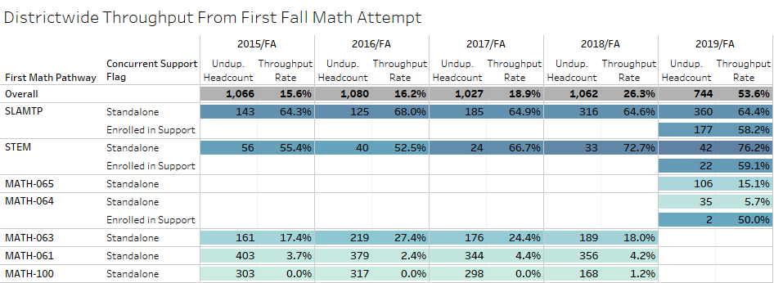
Math One-Year Throughput to Transfer Level Coursework
One-year throughput from lower levels of math sequence (100 and 061) was virtually impossible
Throughput rate tripled in four years: 16% to 54% for fall 2019 students
Keep in mind: graduation requirement is Algebra 2 – transfer math not required for all degrees
Need to look at the various possible pathways for students in post-AB 705 algebra
Notes:
Analysis: Here we have throughput of students that made their first attempt in the subject in fall starting with fall 2015 to last year’s fall 2019. Fall 2018 was the last throughput year without corequisite remediation. And in this case, it split up by the different math pathways.
For fall 2015 overall, 15.6% students that made it through to transfer level completion and was largely driven by students that started off in a traditional standalone English 1A. For all the students starting off in anything below transfer level (more than 60% of all students making their first English attempt), only 24.8% were able to successfully complete within one year. Were these remedial courses maximizing a students’ likelihood of successfully completing transfer level courses?
Looking ahead to where we are now with the first full AB705 throughput year and the benefit of hindsight, no, we weren’t.
The overall throughput was 53.6% for making their first attempt in English in Fall 2019. An important difference from English, the number of students making their first attempt in math has gone down from 1066 in 2015 to 744 in fall 2019. Are students delaying math until spring? Looking back at course success and enrollments slides, that didn’t seem to be the case. Instead it seems that students were likely just delaying [period].
As for the first group of students moving through corequisite remediation fared, there are some differences. For non-STEM, starting off enrolled in corequisite support had a throughput of 58% vs. 64% in standalone. For STEM student starting off in corequisite, throughput was 59% vs. 76% in standalone.
One thing to note is that due to the dramatic decrease in the number of students making their first fall math attempt, the number of students successfully completing transfer level math within one year has still increased with around 280 in fall 2018 vs. 399 for fall 2019.

Slide 19
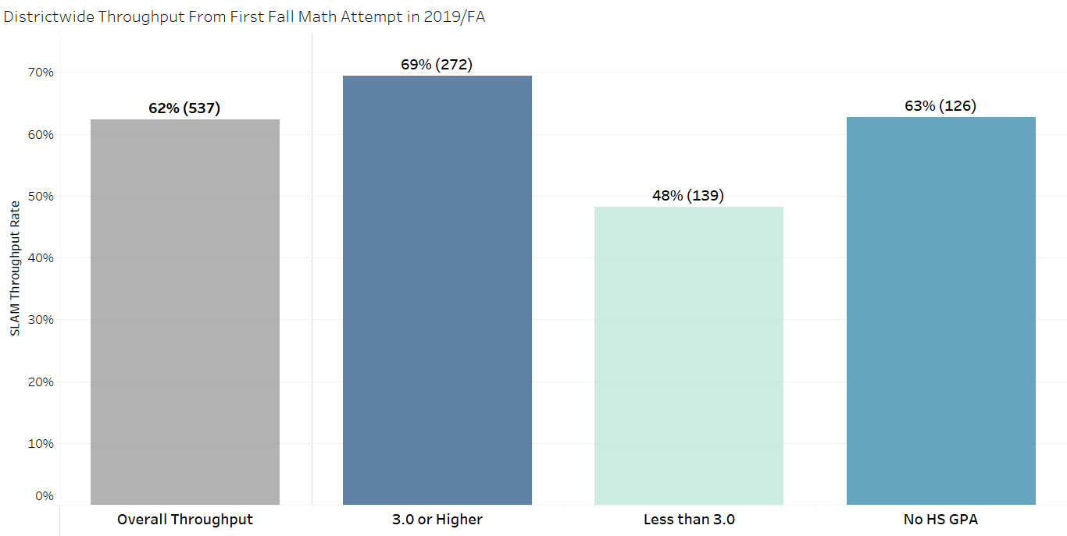
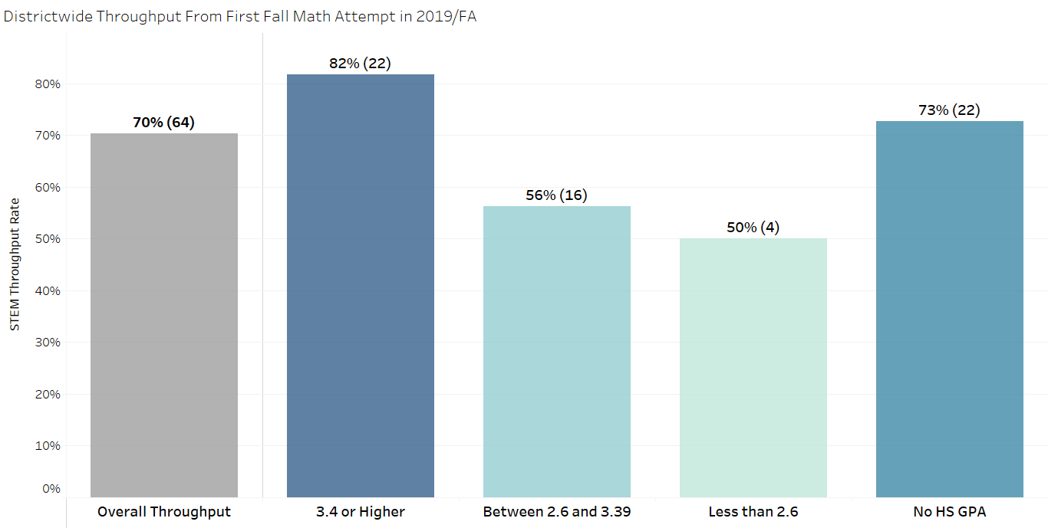
Disaggregated Throughput by HS GPA Buckets for Math
Districtwide Throughput for Fall 2019 for SLAM/TP (Math-052, -025, -10A, -045)
...and STEM (Math-015, -016, -001A)
Notes:
Similar to English, very close, more or less, to baseline success rates from the statewide data.
But wait, how are there low GPA students in standalone? Remember, students are placed still placed by multiple measures: could be student came in with transcript but EQ was entered, student took an AP course, old placement exams are still around -> bottom line, students are to be assessed by multiple measures and their highest assessment is what determines where they can enroll.

Slide 20
Districtwide Equity in Throughput - Math
Group | 2017/FA | 2018/FA | 2019/FA
Overall | 19% | 26% | 54%
DSPS | 5% | 17% | 40%
Female | 21% | 30% | 55%
Male | 16% | 21% | 51%
Online | 28% | 29% | 54%
Face to Face | 17% | 21% | 54%
Hybrid | 12% | 38% | 63%
White | 25% | 30% | 56%
African American | 9% | 17% | 44%
American Indian/Alaska Native | 0%* | 20%* | 50%*
Asian | 48% | 58% | 71%
Filipino | 53% | 55% | 53%
Hispanic | 16% | 25% | 54%
Pacific Islander | 0%* | 0%* | 100%*
Two or More Races | 18% | 26% | 44%
Red Highlight = DI
* n-size of 10 or fewer
Notes:
DSPS:
Large increase in throughput for DSPS students, but equity gap remains virtually unchanged
Gender:
Persistent gender gap of approximately x% in spite of overall increased throughput
Inst. Method:
-Keep in mind that for the smaller n-size instructional methods, we could very well be looking at 1-2 specific sections, versus other small n-size situations like race, etc. where those students are still going to be distributed across different sections, instructors, etc.
-It is promising to see that throughput from face-to-face is about the same as online, however, for fall 2020 it is important to keep in mind that students did not get the choice in selecting an instructional method that works best for them.
Race/Ethnicity:
-Fewer and smaller equity gaps
-Hispanic/Latinx students at parity with White students

Slide 21
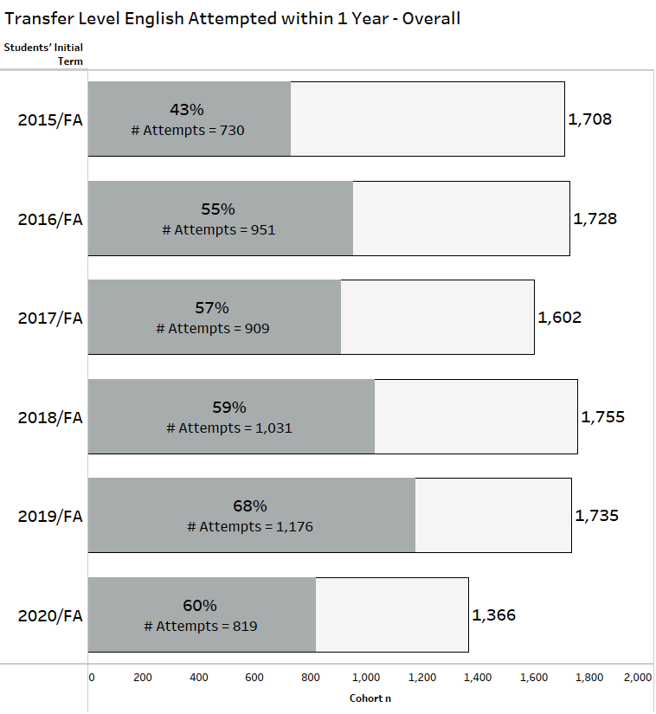
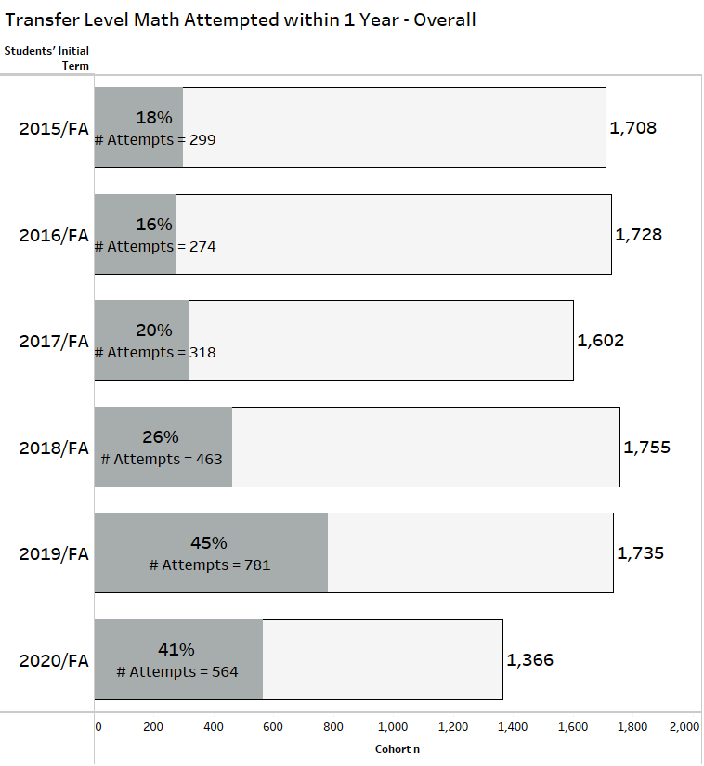
Access – Overall – Who is Attempting English and Math Percentage of First-Time Students Attempting English and Math
Fall 2020 cohort based on current fall and spring enrollment (as of 11/3/2020)
Notes:
ADD FALL 2020 (in progress cohort)
We've been looking at whether completion of transfer level English & math was equitable, but what about just attempting transfer level? Are there student groups who are less likely to even attempt transfer level math and English?
Here we change gears (and datasets) to think about access to transfer level coursework. Like we mentioned earlier, throughput is a type of cohort tracking but it is not the type the same as a first-time fall cohort tracking. We use throughput to ensure we are meeting the letter of the law, however to think about how and when students meet key early momentum points, it helpful to change the frame to the first year experience.
By using first-time fall cohorts, we are able to include and recognize the coursework of students bring with them from their high school years to their first post-high school year. And we get a better idea of how students are starting their post-high school journey’s as the more “traditional” student.
Here we have the proportions of the past five fall cohorts that made an attempt at transfer level English and math sometime by the end of their first year. And these proportions certainly show that the work across the district has grown access to transfer level coursework in both subjects. However, on the disaggregated throughput slides, there were some areas of concern and really begged the question of whether specific sub-populations are experiencing critical barriers to enrollment in transfer level coursework. The method to try and answer this is to compare the proportion of the sub-population in the cohort to the proportion of the sub-population in the cohort that made an attempt in the subject – something that isn’t really possible with a throughput rate because throughput requires an attempt to be made in order to create an initial point to track from.

Slide 22
Access: First-time Students Attempt Transfer Level English by End of Year 1
 | First-Time Fall Cohorts
 | 2015/FA | 2016/FA | 2017/FA | 2018/FA | 2019/FA | 2020/FA*
Overall Cohort n | 1,708 | 1,728 | 1,602 | 1,755 | 1,736 | 1,368
Overall Rate for Attempts at Transfer Level English | 43% | 55% | 57% | 59% | 68% | 60%
Female | 43% | 54% | 59% | 59% | 68% | 63%
Male | 42% | 56% | 54% | 58% | 68% | 55%
Hispanic | 42% | 57% | 59% | 62% | 72% | 65%
White Non-Hispanic | 51% | 50% | 52% | 52% | 62% | 50%
African-American | 29% | 51% | 46% | 56% | 63% | 52%
Two or More Races | 47% | 57% | 60% | 56% | 69% | 61%
Asian | 32% | 51% | 56% | 38% | 38% | 29%
Filipino | 53% | 63% | 81% | 59% | 77% | 61%
American Indian/ Alaskan Native | 0% | 67% | 20% | 44% | 64% | 50%
Pacific Islander | 0% | 86% | 0% | 33% | 50% | 67%
*In Progress, Includes Spring '21
Red Highlight Indicates a Rate that is Less than the 80% Rule (therefore DI)
Yellow Highlight Indicates a Rate Less than the Overall but Higher than 80% Rule
Notes:
Asian students have the most inconsistent (and DI) access to TL English. Good to see Hispanic students accessing TL English a high rate compared to the overall and since the implementation of corequisites, are consistently higher than White students (often used as the reference group for DI calcs). Male students seem to on unstable ground but were at parity with female for last fall's cohort.

Slide 23
Access: First-time Students Attempt Transfer Level Math by End of Year 1
 | First-Time Fall Cohorts
 | 2015/FA | 2016/FA | 2017/FA | 2018/FA | 2019/FA | 2020/FA*
Overall Cohort n | 1,708 | 1,728 | 1,602 | 1,755 | 1,736 | 1,368
Overall Rate for Attempts at Transfer Level Math | 18% | 16% | 20% | 26% | 45% | 41%
Female | 16% | 15% | 20% | 28% | 48% | 45%
Male | 20% | 17% | 20% | 24% | 42% | 36%
Hispanic | 15% | 15% | 19% | 27% | 49% | 44%
White Non-Hispanic | 24% | 16% | 22% | 28% | 42% | 32%
African-American | 10% | 13% | 14% | 19% | 33% | 33%
Two or More Races | 24% | 17% | 17% | 20% | 39% | 42%
Asian | 28% | 33% | 35% | 27% | 23% | 34%
Filipino | 28% | 19% | 23% | 41% | 43% | 52%
American Indian/ Alaskan Native | 0% | 17% | 0% | 11% | 45% | 67%
Pacific Islander | 0% | 29% | 0% | 0% | 38% | 67%
*In Progress, Includes Spring '21
Red Highlight Indicates a Rate that is Less than the 80% Rule (therefore DI)​
Yellow Highlight Indicates a Rate Less than the Overall but Higher than 80% Rule​
​
Notes:
Black/African-American students most consistently face disproportionate impact in access to TL math.

Slide 24
Next Steps and what do you want to see?
AB 705
We wait for fall to wrap and will revisit course success and first term transfer level completion
Untangling the impact of the transition to remote instruction
Compare Fall 2019 by instructional modality to Fall 2020 online
Curriculum changes to look at
Need more time/data to fully assess STEM pathway:
MATH-065 Algebra for STEM
MATH-016 Precalc & Trig
MATH-052 Statistical Literacy – Where does this fit in?

Slide 25
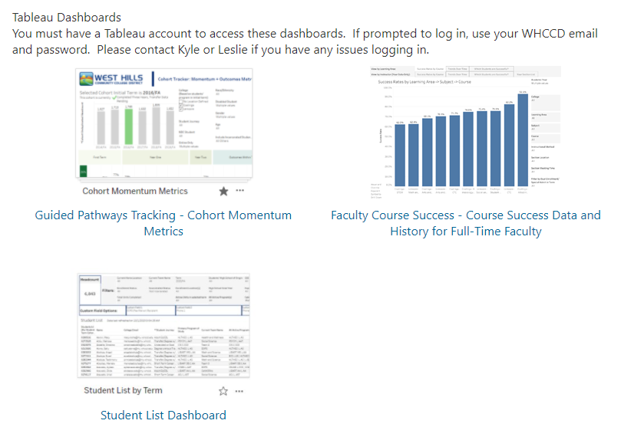
What data dashboards should we be checking?
Faculty, especially math and English
Faculty Dashboards – monitor course success and check for disproportionate impact in your own courses or drilldown from Learning Area to Course Success
Counseling/Advising
Student List by Term shows each student’s current progress (or lack of) in transfer level math and English
Admin and Everyone
Cohort metrics to monitor progress on first year transfer level attempt and successful completion
All of these are linked on the WHCCD Reporting Site:
https://my.whccd.edu/organizations/reporting/default.aspx

Slide 26
Helpful Links and Resources
What is AB 705: https://assessment.cccco.edu/ab-705-implementation#:~:text=The%20bill%20requires%20that%20a,of%20the%20following%3A%20high%20school
AB 705 Implementation Memo: https://static1.squarespace.com/static/5a565796692ebefb3ec5526e/t/5b6ccfc46d2a73e48620d759/1533857732982/07.18+AB+705+Implementation+Memorandum.pdf.pdf

Slide 27
Questions?
Thanks!
Evaluation survey and link to recording will be sent out in the next couple days

